Slide 1
Luxury House Sales Analysis-Bangaluru
Name : Deepika R
Course : Data Science Capstone Project

Slide 2
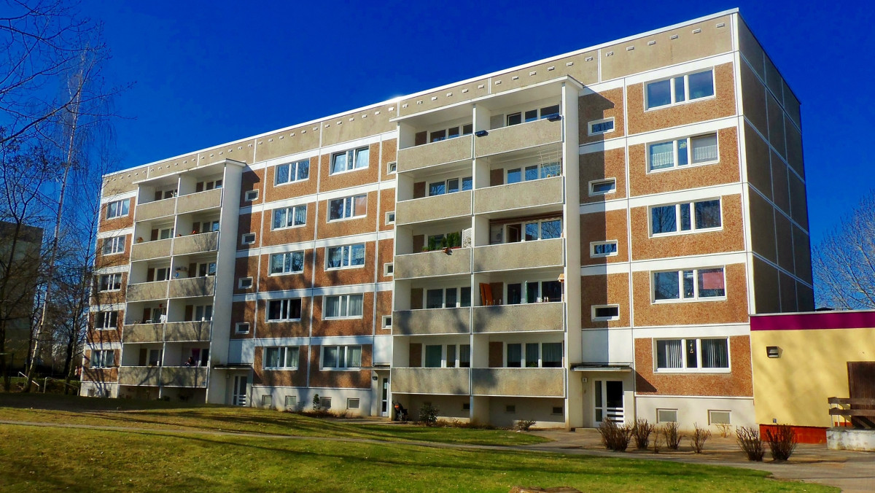
Summary
Luxury Housing Sales Analysis – Bengaluru Developed an end-to-end real estate analytics project using Python, SQL, and Power BI. Cleaned and processed 1,00,000+ records to uncover insights on market trends, builder performance, buyer behavior, and pricing strategies, delivering interactive dashboards for decision-making.

Slide 3
OBJECTIVES
To clean and preprocess raw housing data using Python.
To store and query the refined dataset in SQL for structured analysis.
To design interactive dashboards in Power BI for real-time insights.
To analyze market trends, builder performance, buyer personas, and pricing strategies
.
To replicate a real-world enterprise-level BI & analytics environment.
To support data-driven decision-making in the real estate domain.

Slide 4
Pipe line
Data collecting
Data cleaning
Database
(SQL)
Visualization
(Power Bi)
Insights & Decisions

Slide 5
Data Collecting & data cleaning
Gathered raw sales dataset from the housing project database (CSV/Excel/SQL).
Imported data into Python for cleaning and preprocessing.
Data cleaning;
Handled Missing Values:
Filled missing booking statuses and buyer details where possible.
Dropped unusable records (e.g., rows without project ID).
Removed Duplicates:
Checked for duplicate entries of the same booking/project.
Kept only unique transactions.
Corrected Inconsistencies:
Standardized columns (e.g., “3-BHK”, “3BHK”, “3 bhk” → unified as “3BHK”).
Normalized date formats and price fields.
Outlier Treatment:
Verified extreme ticket prices.
Flagged invalid values (like negative prices).

Slide 6
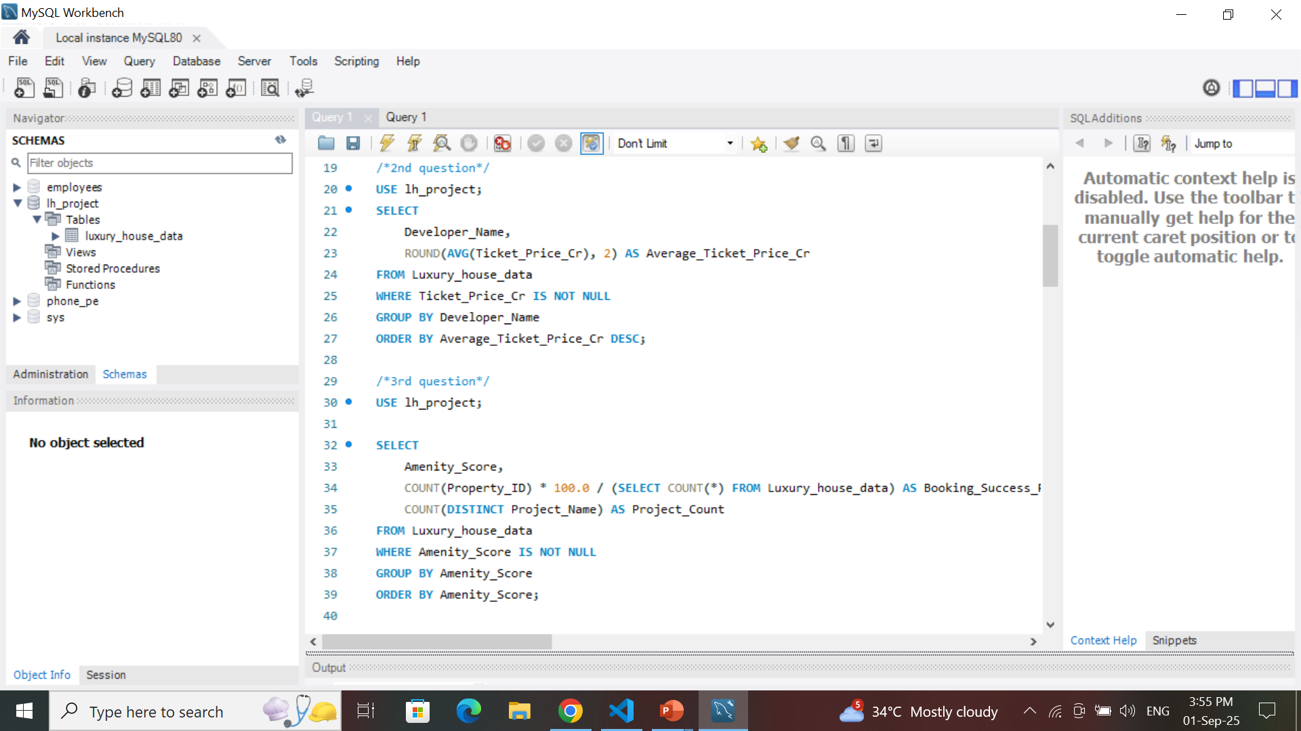
Database(SQL)
Visual of a database
Flow diagram like: Clean data –SQL Database
Builder Performance
Which builders have the highest total ticket sales and how do they rank in terms of average ticket size? → (Bar Chart or Table showing Builder, Sum(Ticket_Price_Cr), Avg(Ticket_Price_Cr))

Slide 7
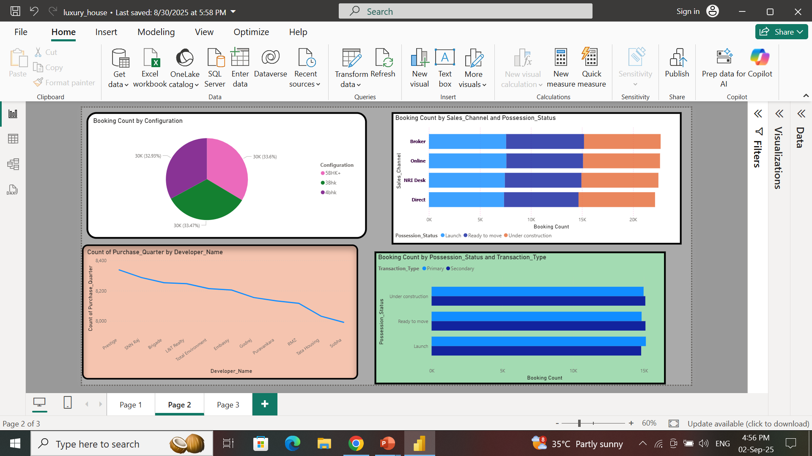
Visualization (Power BI)
Data visualization is the process of presenting insights in graphical form so patterns, trends, and relationships in luxury housing sales can be easily understood.

Slide 8
Steps Followed in Project
Data Import
Connected SQL database to Power BI.
Imported cleaned tables and queries.
Data Modeling
Built relationships between tables (Projects ↔ Bookings ↔ Builders).
Created calculated measures (Booking Conversion Rate, Avg Ticket Size).
Dashboard Creation
Designed interactive visuals for business questions:
📈 Line Chart → Quarterly booking trends.
📊 Bar Chart → Builder performance (total vs avg ticket sales).
🟢 Pie Chart → Configuration demand (3BHK, 4BHK, etc.).
🗺 Map → Micro-market concentration in Bangalore.
🔲 Matrix → Builder contribution per quarter.
Interactivity
Added filters, slicers, and drill-throughs to explore insights by region, builder, or time.

Slide 9
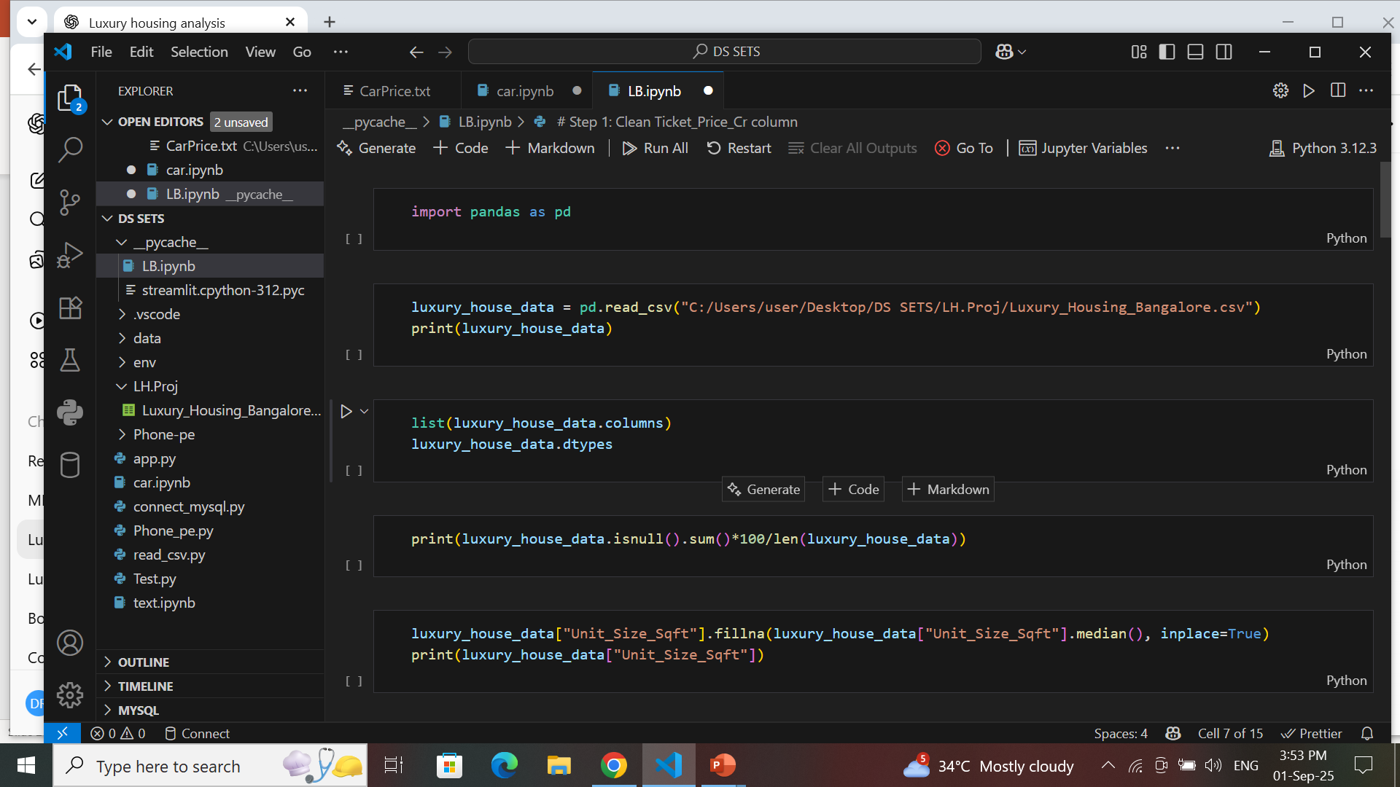
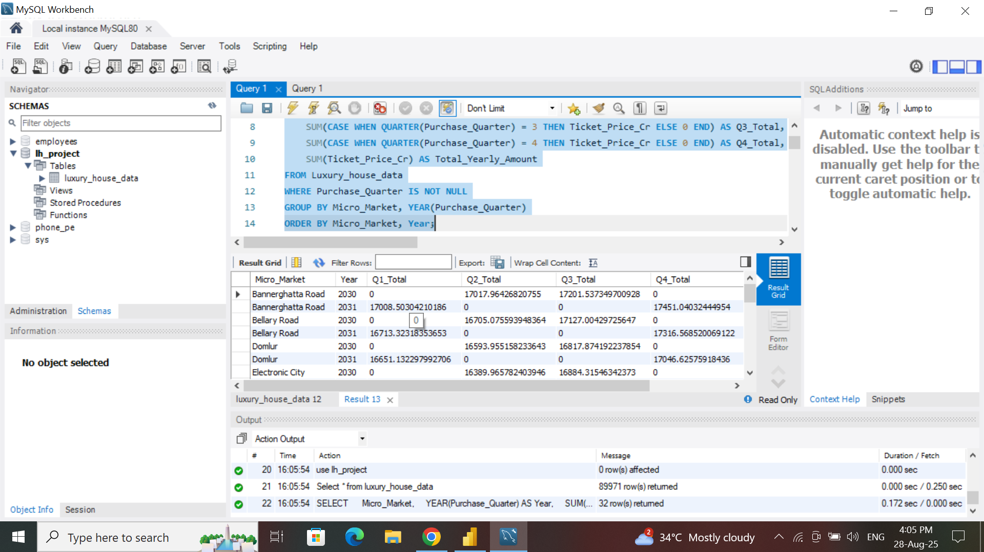
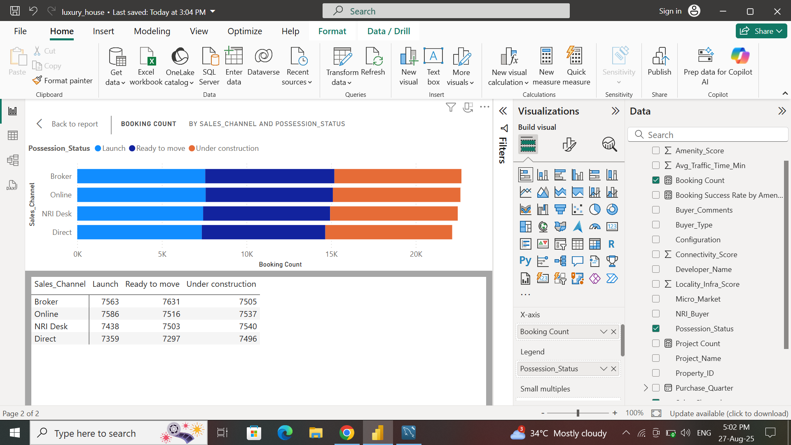
Conclusion
This project provided a comprehensive analysis of the luxury housing sales market in Bangalore.
By applying data cleaning, SQL, and Power BI visualization, raw housing data was transformed into actionable business insights.

